Slide 1



An analysis of Social buzz

Slide 2




Today's agenda
Project recap Problem
The Analytics team Process
Insights Summary

Slide 3



Project
Social Buzz is a fast growing technology unicorn that need to adapt quickly to it's global scale. Accenture has begun a 3 month POC focusing on these tasks:
Recap
An audit of Social Buzz's big data practice.
Recommendations for a successful IPO.
Analysis to find Social Buzz's top 5 most popular categories of content.

Slide 4





Problem
Over 100000 posts per day
36,500,000 pieces of content per year!
But how to capitalize on it when there is much?
Analysis to find social buzz's top 5 most popular categories of content

Slide 5




Andrew Fleming
Chief Technical Architect
The Analytics team
Marcus Rompton
Senior principle
Sudarshanam Yessasvini
Data Analyst

Slide 6

Process
1
Data understanding
2
Data cleaning
3
Data modelling
4
Data analysis
5
Uncover insights

Slide 7

16
Unique categories
Insights
1897
REACTIONS TO
“ANIMAL” POSTS
JANUARY
MONTH WITH MOST POSTS

Slide 8







Top 5 categories
food
66676
technology
68738
healthy eating
69339
science
71168
Animals
74965
62000
64000
66000
68000
70000
72000
74000
76000

Slide 9


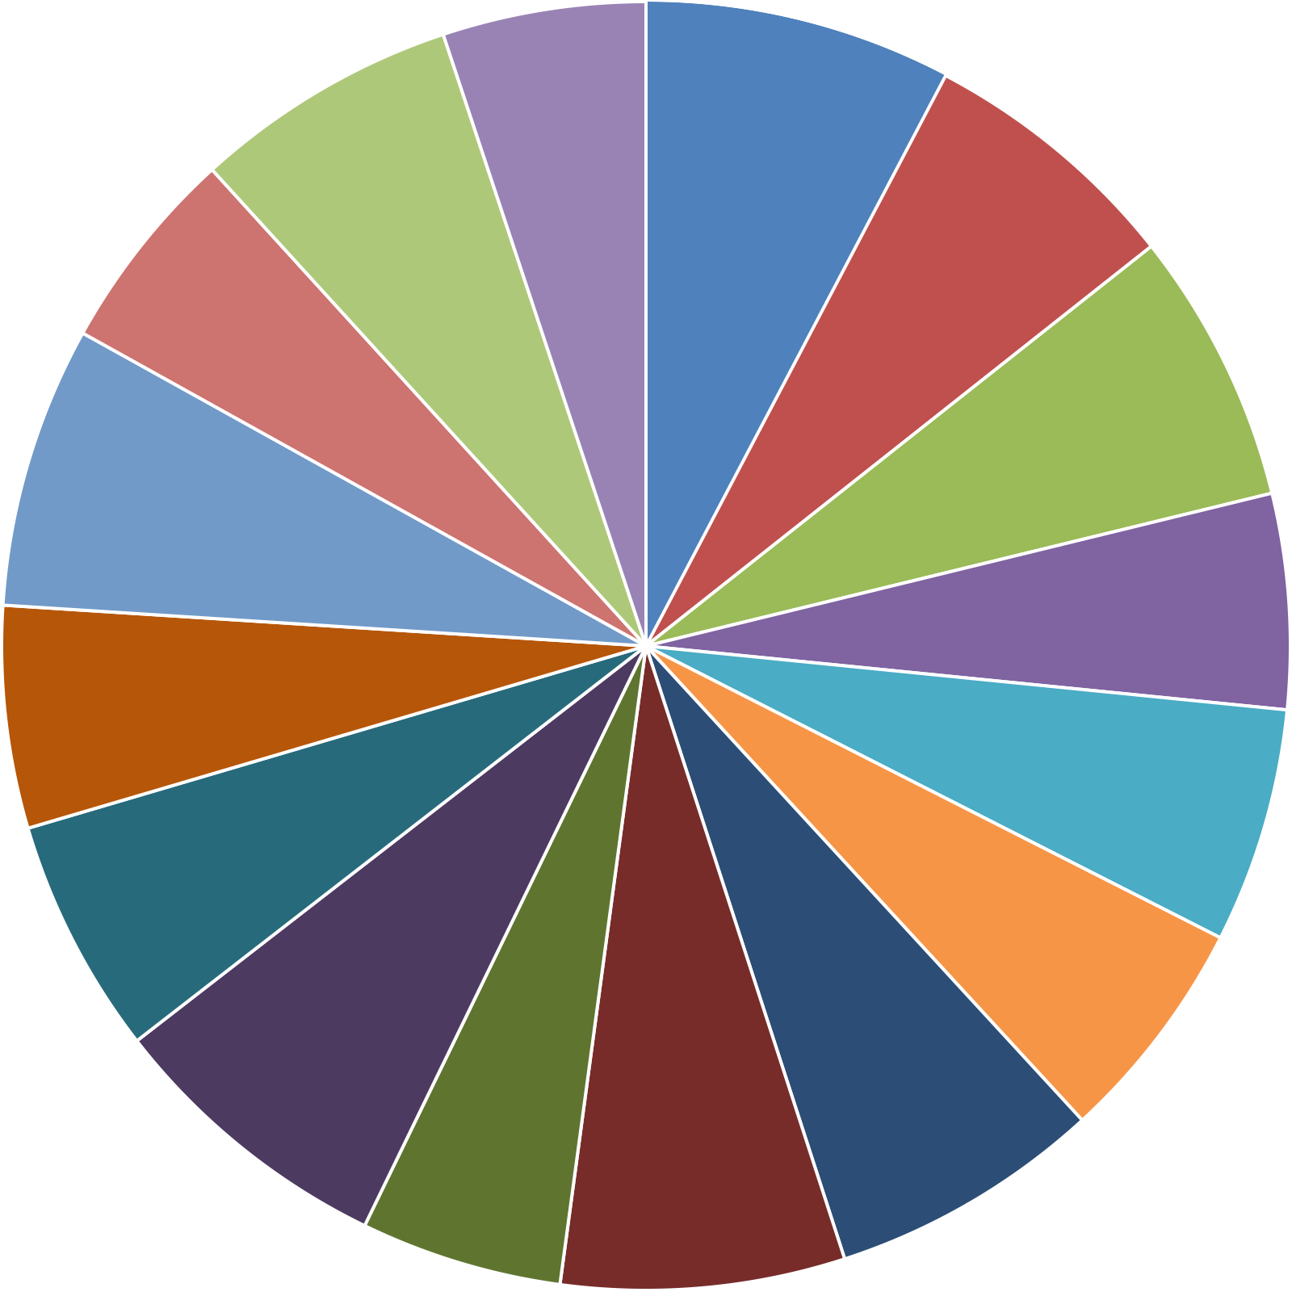
Unique categories
49619
Animals cooking culture dogs education fitness food
healthy eating public speaking science
soccer Studying technology tennis travel veganism
74965
64880
64756
50339
66579
68738
52511
54269
57436
57783
55323
71168
66676
49264
69339

Slide 10


ANALYSIS
Animals and science are the two most popular categories of content, showing that people enjoy "real-life" and "factual" content the most.
INSIGHT
Food is a common theme with the top 5 categories with "Healthy Eating" ranking the highest. This may give an indication to the audience within your user base. You could use this insight to create a campaign and work with healthy eating brands to boost user engagement.
Summary
NEXT STEPS
This ad-hoc analysis is insightful, but it's time to take this analysis into large scale production for real-time understanding of your business. We can show you how to do this.

Slide 11





Thank you!
ANY QUESTIONS?

